Slide 1

CIS280_Final Project Team 6_Member Names: Machot Lat Thiep Jeffrey Hager Alexandria Yeoman

Slide 2
Table of Contents
Introduction
Feasibility Analysis
Project Plan
Requirement Models
Data Flow Diagrams
UML/Object Modeling
Problem Summary

Slide 3
Introduction
The project being introduced by stakeholders is the ADT System. The purpose of the project is to standardize data transfer between departments of a medical facility and between other partnering medical facilities.
The current system includes documentation of patient records on paper which is kept in files. The proposed system converts patient records to all electronic records and introduces a process for medical staff to become paperless. This process will not only provide increased patient data security, but also streamline patient data within the medical facility.

Slide 4

Feasibility Analysis
SWOT Analysis
Fishbone Diagram
Pareto Chart
Feasibility Study
Feasibility Analysis

Slide 5
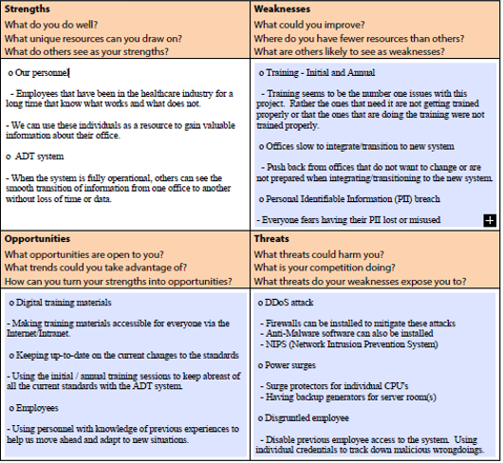
SWOT
Analysis

Slide 6
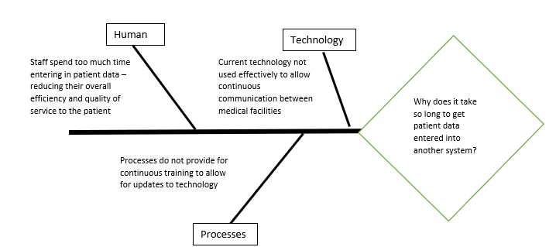
Problem Summary

Slide 7
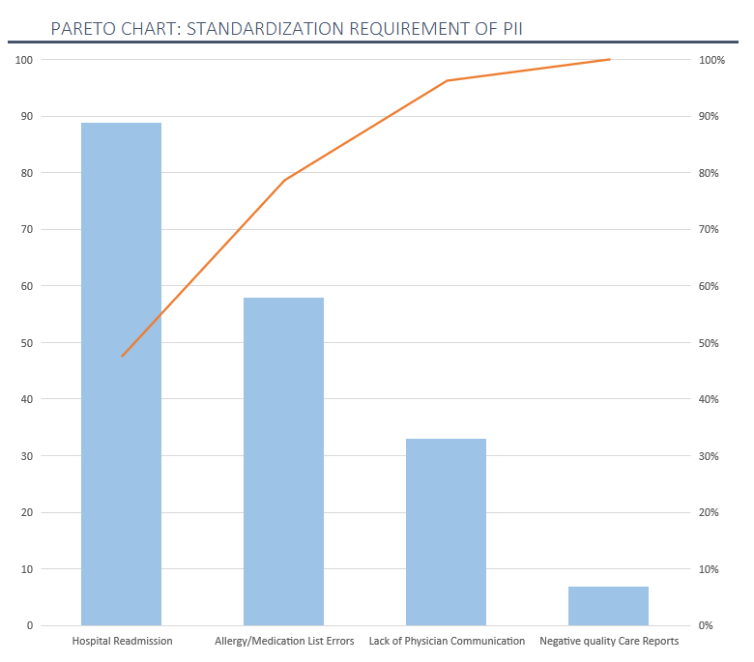
Pareto Chart Readmission Rate vs Hospital Volume
This chart shows us that of these four problems, Hospital Readmission is the current priority

Slide 8
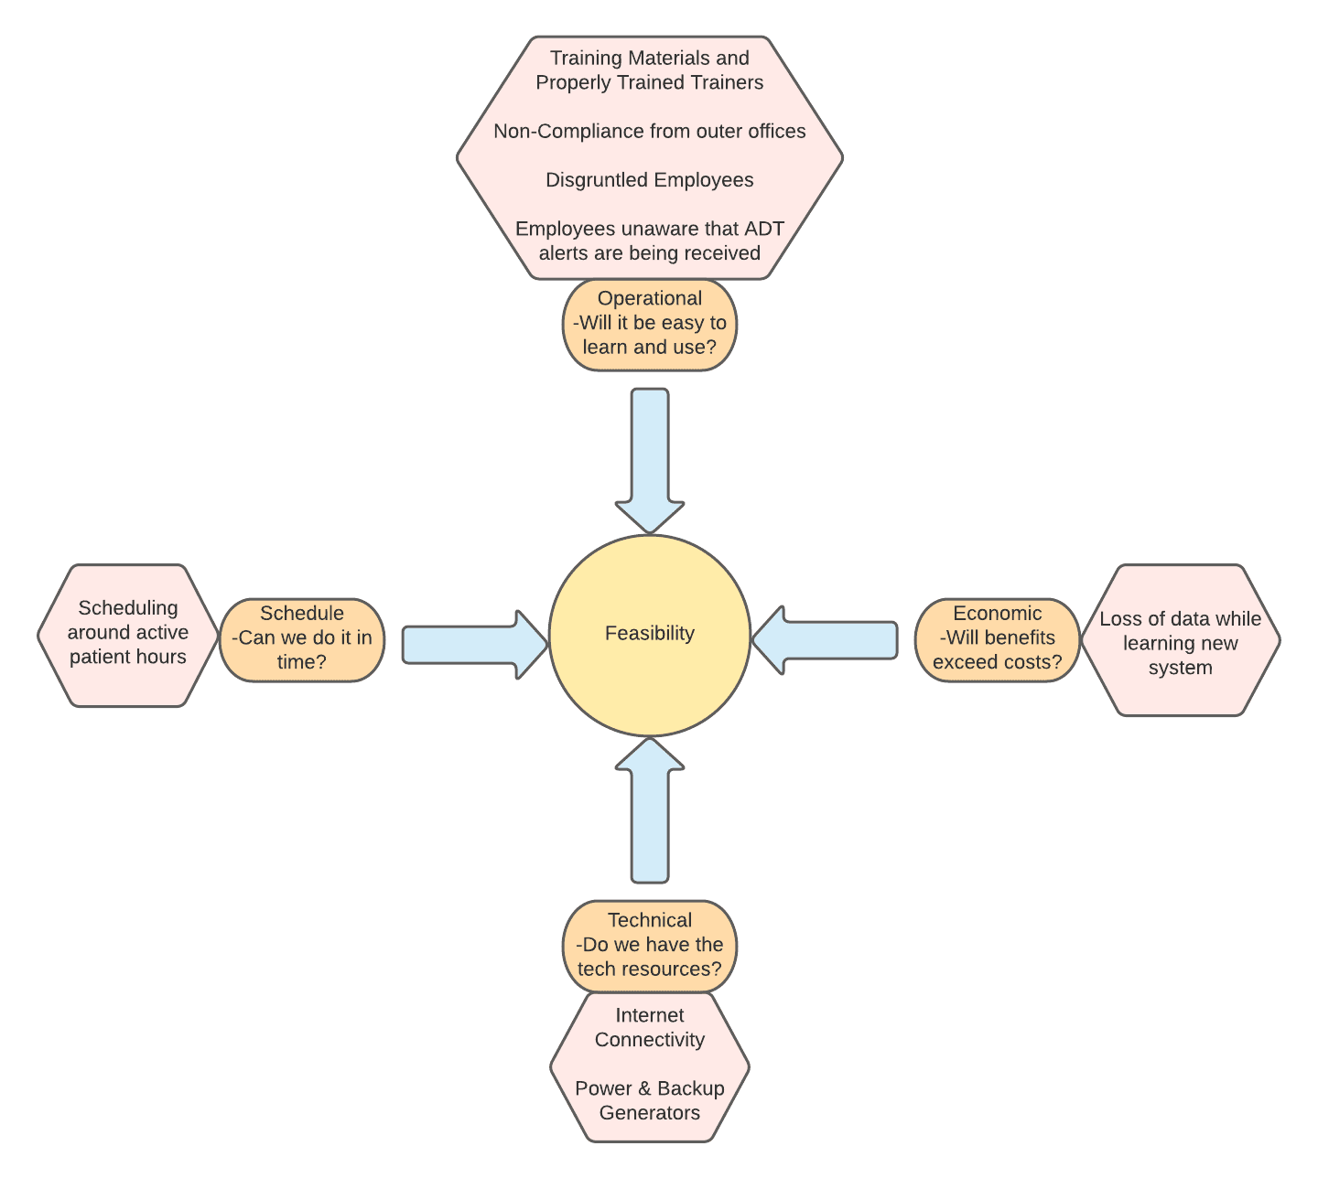
Feasibility Study
A feasibility analysis was completed on the proposed project to illustrate the practicality of the proposed project.
Within the analysis, areas of possible concern were identified including within the operational area.
Specifically, there was a concern about disgruntled employees who could reduce the quality of the updated process. However, disgruntled employees will be disgruntled whether this project was implemented or not – so this was not seen as a major issue for the project.

Slide 9

Project Plan
Sprint Plan
Grantt Chart

Slide 10
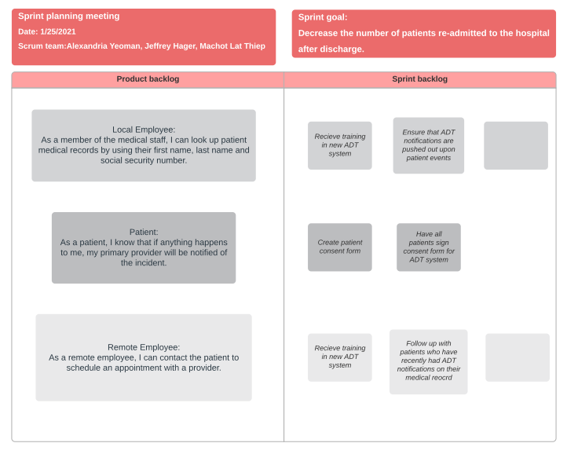
Sprint Planning: User Stories
As a patient, I know that if anything happens to me, my primary provider will be notified of the incident.
As a member of the medical staff, I can look up patient medical records by using their first name, last name and social security number.
As a remote employee, I can contact the patient to schedule an appointment with a provider.

Slide 11
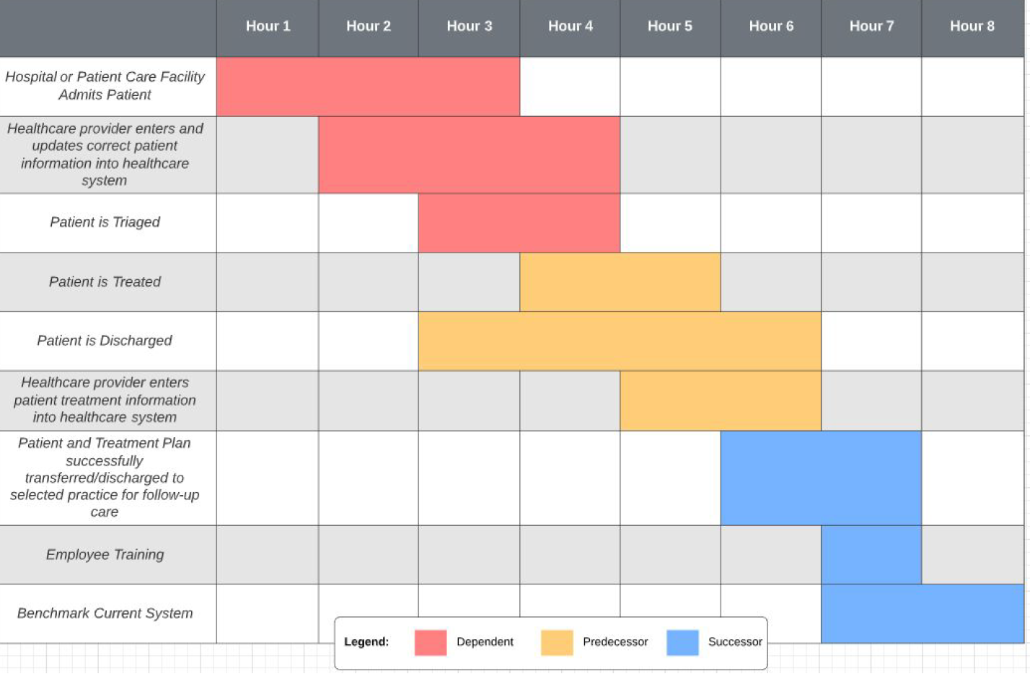
Grantt Chart
Use Case Scenario:
Prepare and Send an ADT Alert. Healthcare providers admit, discharge and transfer a patient using the ADT alert system.

Slide 12
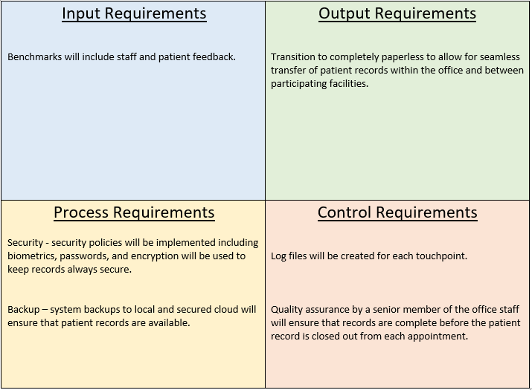
Requirements Models

Slide 13
Fact Finding Overview
Business Functions
The current system supports business functions by allowing providers to still have the capability of charting vital signs, treatment plans and discharging patients however the process of allowing another provider to view that patients visit is more complex, and it is known to lead to hospital readmissions.
Strategic Objectives
The strategic objectives and business requirements that must be supported by the new system are streamlining the management of patient data records, increasing patient data quality, increasing productivity of medical staff and reducing possible data entry errors.
Benefits
The benefits and total cost of ownership (TCO) include the increased security to patient data records by reducing the need for paper. Medical staff can document patient information directly into the new system. As well as the decrease in cost to the hospital from patient readmission, which according to HealthStream(2020), can cost a hospital up to $26 billion annually.

Slide 14
Dataflow Diagrams
Functional Decomposition Diagram (FDD)
Diagram 0
Context Diagram

Slide 15
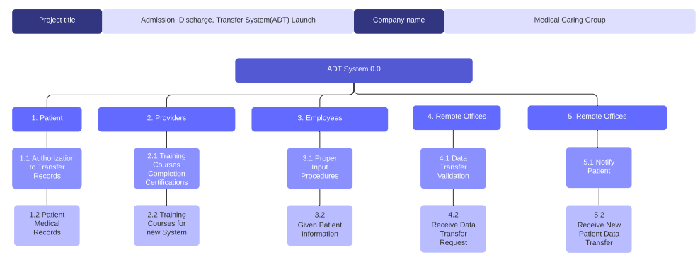
Functional Decomposition Diagram (FDD)

Slide 16
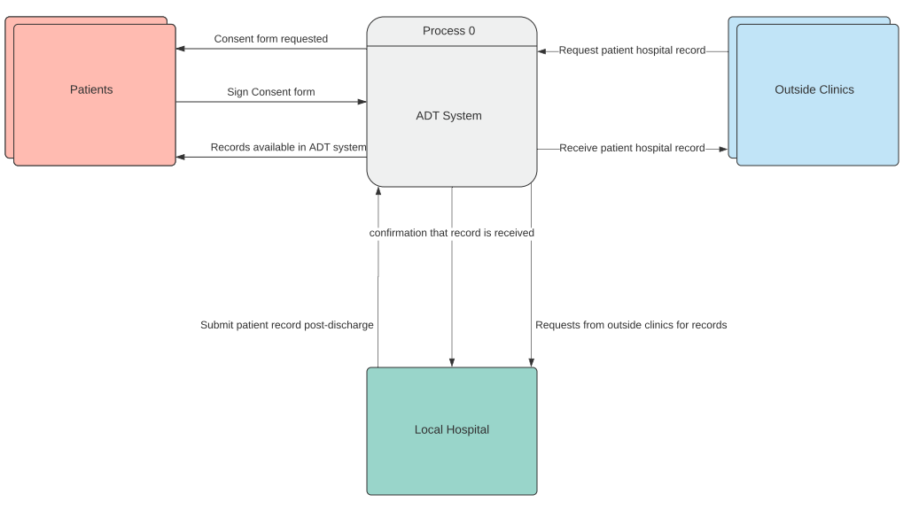
Data Flow Diagram
This Context Diagram illustrates the flow of data starting from when the patient arrives in the office to when they are checked out.
The benefit of the ADT System is the conversion of patient data from paper to all electronic which improves not only patient data security but also increases staff of doctors and staff because data only must be entered once.
Another benefit is that when partnering medical facilities request patient records, staff does not have to spend time to pull a physical file, copy and then fax it.

Slide 17
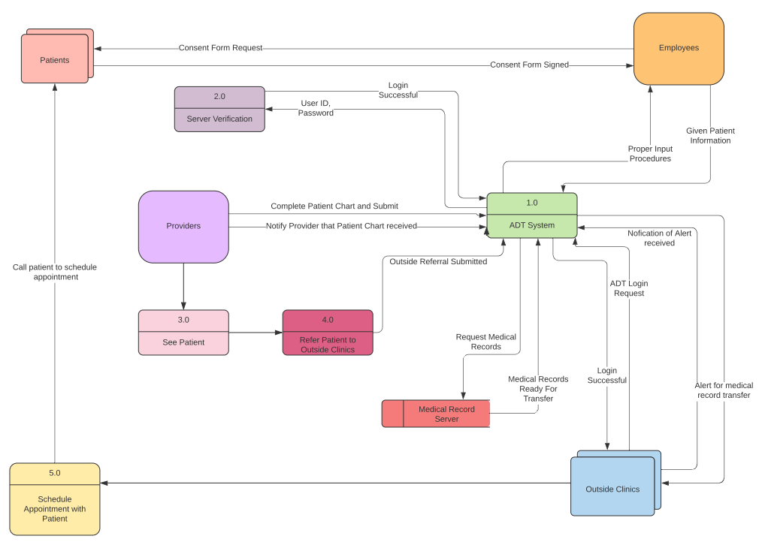
Diagram 0

Slide 18
UML/Object Modeling
Object relationship diagram
Use case Diagram
Activity Diagram
State Transition Diagram
Sequence Diagram
Class Diagram

Slide 19
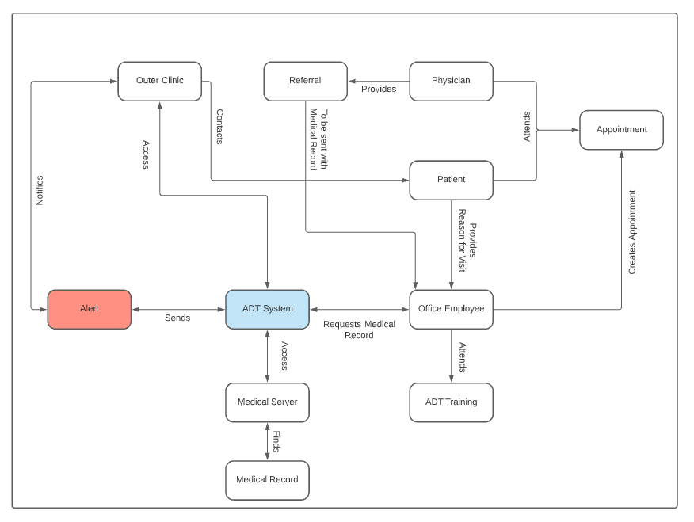
Object Relationship Diagram

Slide 20
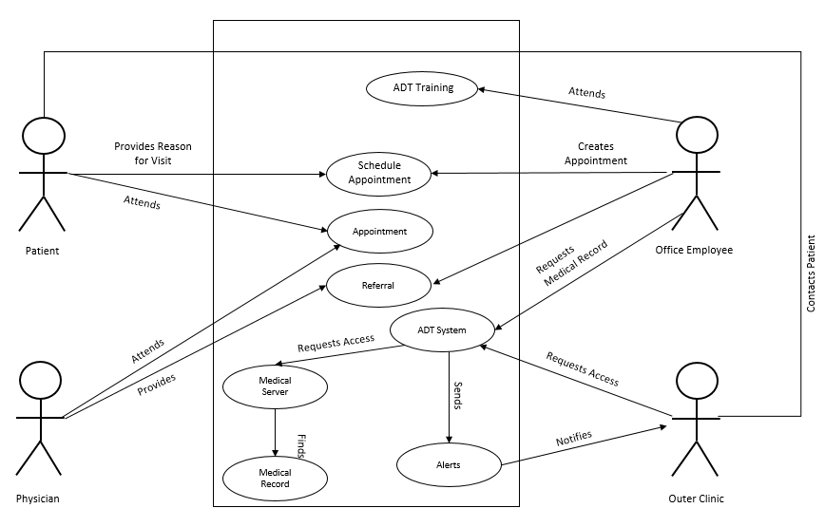
Use Case Diagram

Slide 21
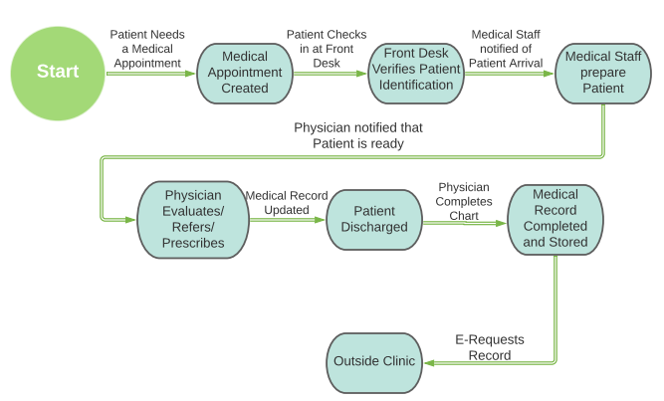
Activity Diagram

Slide 22
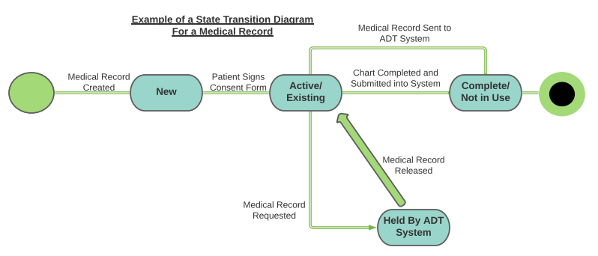
State Transition Diagram
This diagram shows how a medical record changes from one state to another.

Slide 23

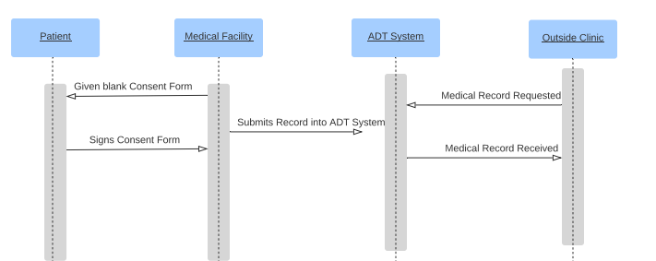
Sequence Diagram

Slide 24
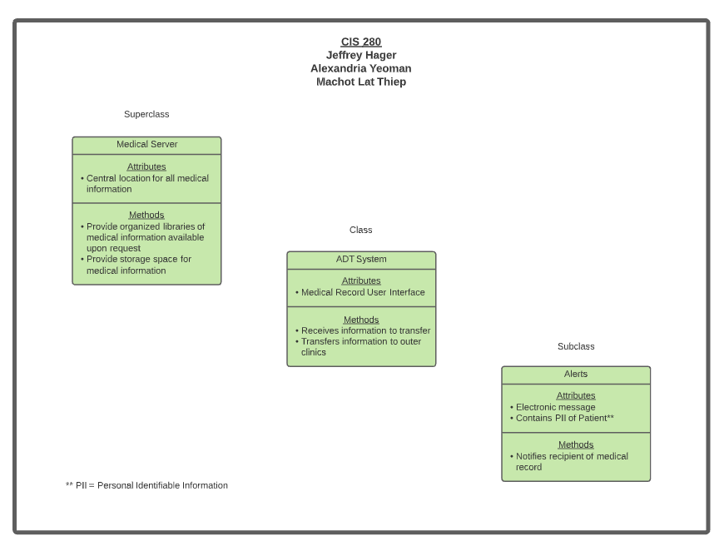

Slide 25
Bibliography
Felix, Holly C, Beverly Seaberg, Zoran Bursac, Jeff Thostenson, and M Kathryn Stewart. "Why Do Patients Keep Coming Back? Results of a Readmitted Patient Survey." Social Work in Health Care. U.S. National Library of Medicine, 2015. https://www.ncbi.nlm.nih.gov/pmc/articles/PMC4731880/
HealthStream. “The Economic & Emotional Cost of Hospital Readmissions”. HealthStream. 2020. https://www.healthstream.com/resources/blog/blog/2020/06/02/the-economic-emotional-cost-of-hospital-readmissions

